Slide 1
Chapter 10: File-System Interface

Slide 2
Outline
File Concept
Access Methods
Disk and Directory Structure
Protection
Memory-Mapped Files
Objectives
File Concept
Access Methods
Disk and Directory Structure
Protection
Memory-Mapped Files
File system : A collection of files; A directory structure

Slide 3
File Concept
Contiguous logical address space
Types:
Data
Numeric
Character
Binary
Program
Contents defined by file’s creator
Many types
text file,
source file,
executable file

Slide 4
File Attributes
Name – only information kept in human-readable form
Identifier – unique tag (number) identifies file within file system
Type – needed for systems that support different types
Location – pointer to file location on device
Size – current file size
Protection – controls who can do reading, writing, executing
Time, date, and user identification – data for protection, security, and usage monitoring
Information about files are kept in the directory structure, which is maintained on the disk
Many variations, including extended file attributes such as file checksum
Information kept in the directory structure

Slide 5
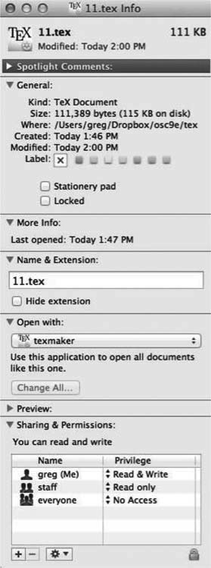
File info Window on Mac OS X

Slide 6
Directory Structure
A collection of nodes containing information about all files
Both the directory structure and the files reside on disk

Slide 7
File Operations
Create
Write – at write pointer location
Read – at read pointer location
Reposition within file - seek
Delete
Truncate
Open (F_{i}) – search the directory structure on disk for entry F_{i}, and move the content of entry to memory
Close (F_{i}) – move the content of entry F_{i} in memory to directory structure on disk

Slide 8
Open Files
Several pieces of data are needed to manage open files:
Open-file table: tracks open files
File pointer: pointer to last read/write location, per process that has the file open
File-open count: counter of number of times a file is open – to allow removal of data from open-file table when last processes closes it
Disk location of the file: cache of data access information
Access rights: per-process access mode information

Slide 9
File Locking
Provided by some operating systems and file systems
Similar to reader-writer locks
Shared lock similar to reader lock – several processes can acquire concurrently
Exclusive lock similar to writer lock
Mediates access to a file
Mandatory or advisory:
Mandatory – access is denied depending on locks held and requested
Advisory – processes can find status of locks and decide what to do

Slide 10
File Locking Example – Java API
import java.io.*;
import java.nio.channels.*;
public class LockingExample {
public static final boolean EXCLUSIVE = false;
public static final boolean SHARED = true;
public static void main(String arsg[]) throws IOException {
FileLock sharedLock = null;
FileLock exclusiveLock = null;
try {
RandomAccessFile raf = new RandomAccessFile("file.txt", "rw");
// get the channel for the file
FileChannel ch = raf.getChannel();
// this locks the first half of the file - exclusive
exclusiveLock = ch.lock(0, raf.length()/2, EXCLUSIVE);
/** Now modify the data . . . */
// release the lock
exclusiveLock.release();

Slide 11
File Locking Example – Java API (Cont.)
// this locks the second half of the file - shared
sharedLock = ch.lock(raf.length()/2+1, raf.length(), SHARED);
/** Now read the data . . . */
// release the lock
sharedLock.release();
} catch (java.io.IOException ioe) {
System.err.println(ioe);
}finally {
if (exclusiveLock != null)
exclusiveLock.release();
if (sharedLock != null)
sharedLock.release();
}
}
}

Slide 12
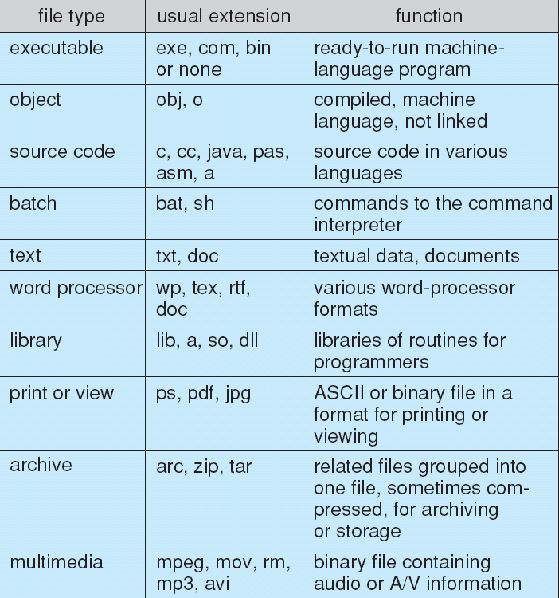
File Types – Name, Extension

Slide 13
File Structure
None - sequence of words, bytes
Simple record structure
Lines
Fixed length
Variable length
Complex Structures
Formatted document
Relocatable load file
Can simulate last two with first method by inserting appropriate control characters
Who decides:
Operating system
Program

Slide 14
Access Methods
A file is fixed length logical records
Sequential Access
Direct Access
Other Access Methods

Slide 15
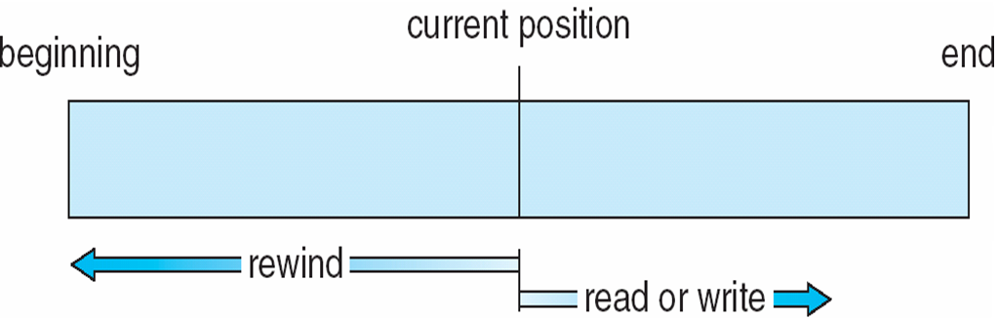
Sequential Access
Operations
read next
write next
Reset
no read after last write (rewrite)
Figure

Slide 16
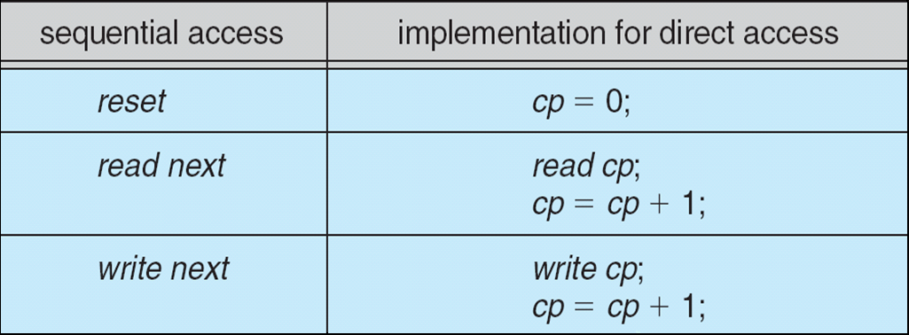
Direct Access
Operations
read n
write n
position to n
read next
write next
rewrite n
n = relative block number
Relative block numbers allow OS to decide where file should be placed

Slide 17
Other Access Methods
Can be other access methods built on top of base methods
General involve creation of an index for the file
Keep index in memory for fast determination of location of data to be operated on (consider Universal Produce Code (UPC code) plus record of data about that item)
If the index is too large, create an in-memory index, which an index of a disk index
IBM indexed sequential-access method (ISAM)
Small master index, points to disk blocks of secondary index
File kept sorted on a defined key
All done by the OS
VMS operating system provides index and relative files as another example (see next slide)

Slide 18
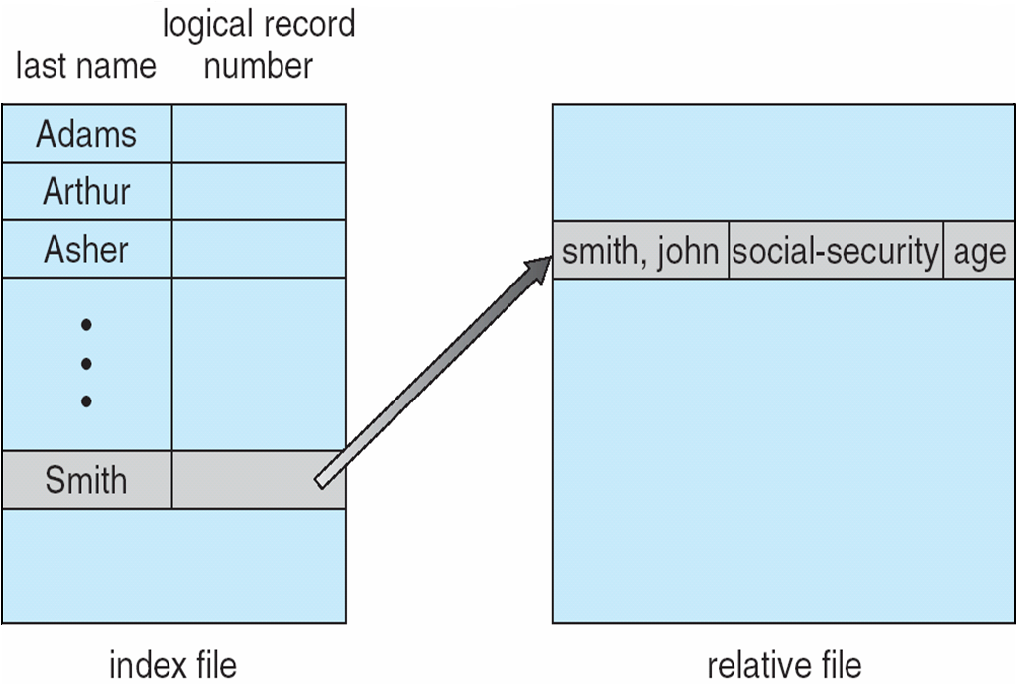
Example of Index and Relative Files

Slide 19
Disk Structure
Disk can be subdivided into partitions
Disks or partitions can be RAID protected against failure
Disk or partition can be used raw – without a file system, or formatted with a file system
Partitions also known as minidisks, slices
Entity containing file system is known as a volume
Each volume containing a file system also tracks that file system’s info in device directory or volume table of contents
In addition to general-purpose file systems there are many special-purpose file systems, frequently all within the same operating system or computer

Slide 20
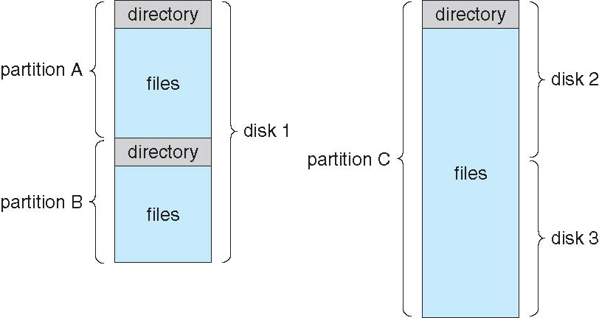
A Typical File-system Organization

Slide 21
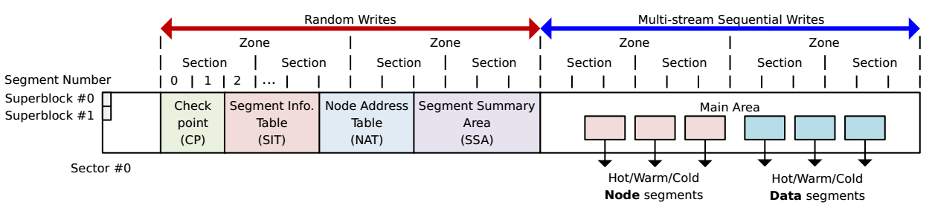
Example: Flash Friendly File System(F2FS)
F2FS: a file system exploiting NAND flash memory-based storage devices
Superblock: It contains basic partition information of F2FS.
Checkpoint: It contains many temporary meta data which is used for improving disk life and recover file data when FS crashes.
Segment Info. Table & Node Address Table: They manage meta information of blocks and nodes respectively.
Segment Summary Area: It contains summary entries which contains the owner information of all the data in Main area.
Main Area: It contains all file data which is stored as blocks on FS.

Slide 22
Types of File Systems
We mostly talk of general-purpose file systems
But systems frequently have many file systems, some general- and some special- purpose
Consider Solaris (Unix) has
tmpfs – memory-based volatile FS for fast, temporary I/O
objfs – interface into kernel memory to get kernel symbols for debugging
ctfs – contract file system for managing daemons
lofs – loopback file system allows one FS to be accessed in place of another
procfs – kernel interface to process structures
ufs, zfs – general purpose file systems

Slide 23
Directory Structure
A collection of nodes containing information about all files
Both the directory structure and the files reside on disk

Slide 24
Directory Organization
The directory is organized logically to obtain
Efficiency – locating a file quickly
Naming – convenient to users
Two users can have same name for different files
The same file can have several different names
Grouping – logical grouping of files by properties, (e.g., all Java programs, all games, …)
Operations Performed on Directory
Search for a file
Create a file
Delete a file
List a directory
Rename a file
Traverse the file system

Slide 25
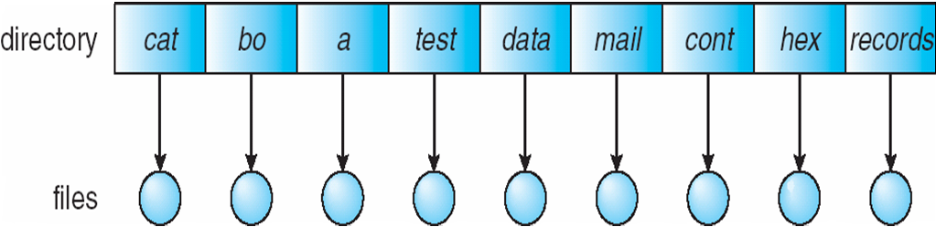
Single-Level Directory
A single directory for all users
Naming problem
Grouping problem

Slide 26
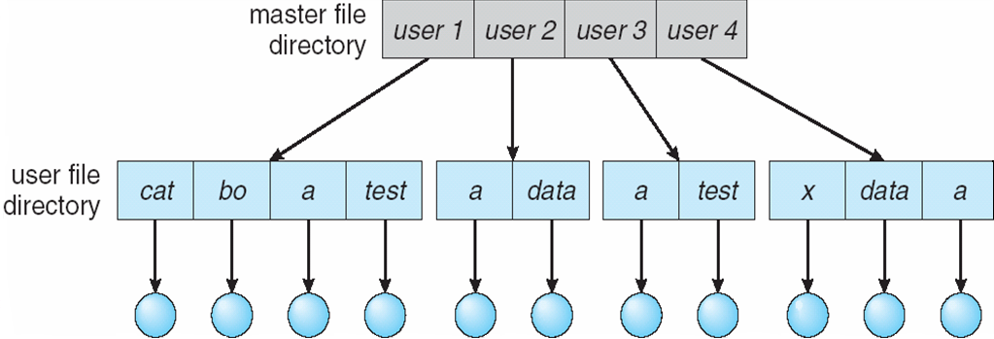
Two-Level Directory
Separate directory for each user
Path name
Can have the same file name for different user
Efficient searching
No grouping capability

Slide 27
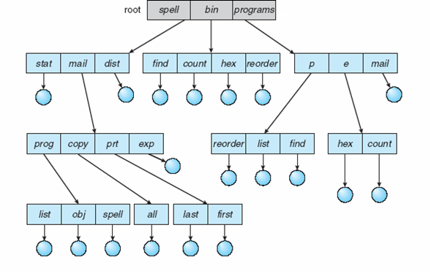
Tree-Structured Directories
Efficient searching
Grouping Capability
Current directory (working directory)
cd /spell/mail/prog
type list

Slide 28
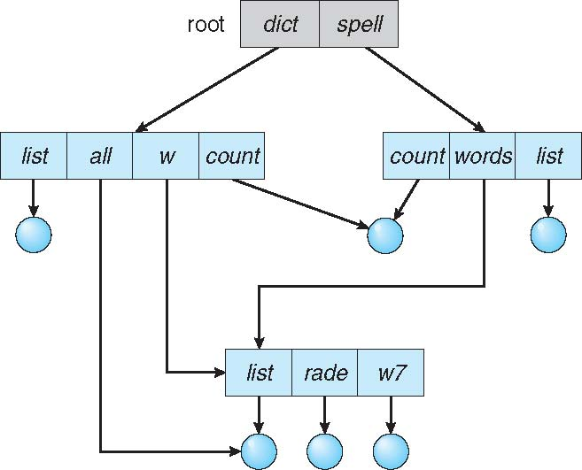
Acyclic-Graph Directories
Have shared subdirectories and files
Example

Slide 29
Acyclic-Graph Directories (Cont.)
Two different names (aliasing)
If dict deletes w/list ⇒ dangling pointer
Solutions:
Backpointers, so we can delete all pointers.
Variable size records a problem
Backpointers using a daisy chain organization
Entry-hold-count solution
New directory entry type
Link – another name (pointer) to an existing file
Resolve the link – follow pointer to locate the file

Slide 30
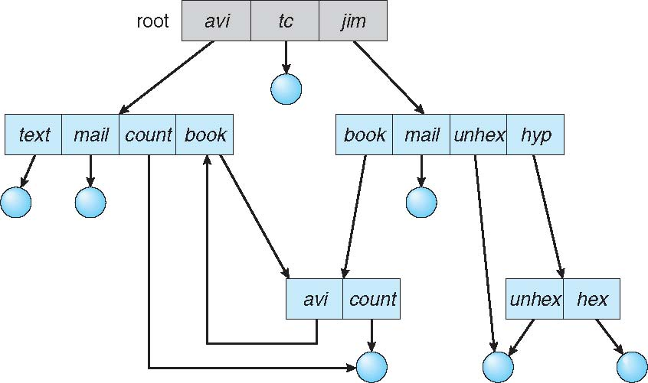
General Graph Directory
How do we guarantee no cycles?
Allow only links to files not subdirectories
Garbage collection: run a periodical process to clean up after a period of time
Every time a new link is added use a cycle detection algorithm to determine whether it is OK

Slide 31
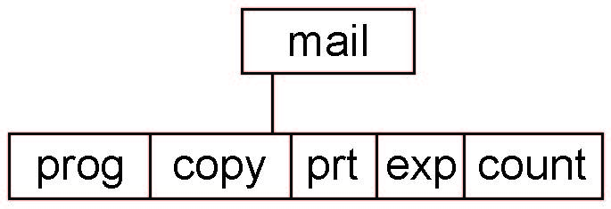
Current Directory
Can designate one of the directories as the current (working) directory
cd /spell/mail/prog
type list
Creating and deleting a file is done in current directory
Example of creating a new file
If in current directory is /mail
The command
mkdir <dir-name>
Results in:
Deleting “mail” ⇒ deleting the entire subtree rooted by “mail”

Slide 32
Protection
File owner/creator should be able to control:
What can be done
By whom
Types of access
Read
Write
Execute
Append
Delete
List

Slide 33
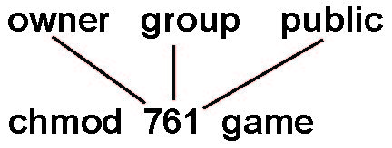
Access Lists and Groups in Unix
Mode of access: read, write, execute
Three classes of users on Unix / Linux
RWX
a) owner access 7 ⇒ 1 1 1 RWX
b) group access 6 ⇒ 1 1 0
RWX
c) public access 1 ⇒ 0 0 1
Ask manager to create a group (unique name), say G, and add some users to the group.
For a file (say game) or subdirectory, define an appropriate access.
Attach a group to a file
chgrp G game

Slide 34
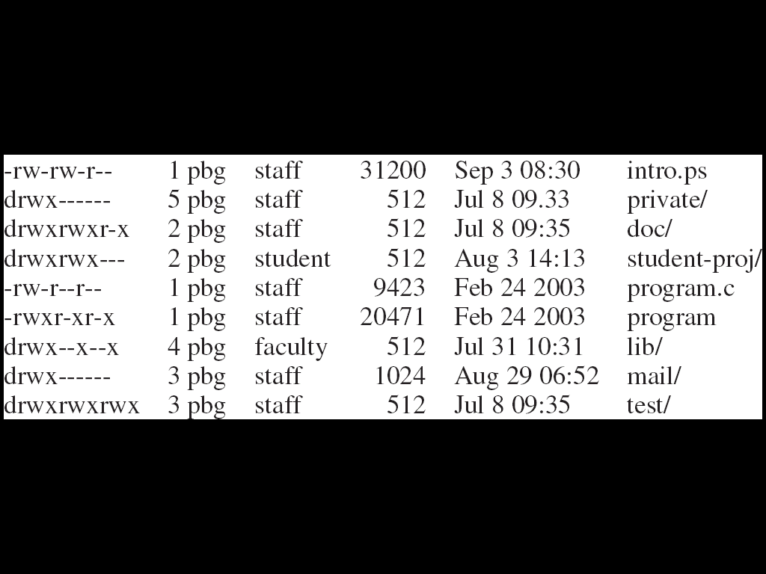
A Sample UNIX Directory Listing

Slide 35
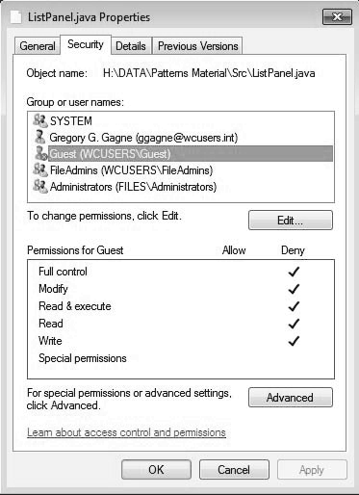
Windows 7 Access-Control List Management

Slide 36
End of Chapter 10

